Slide 1
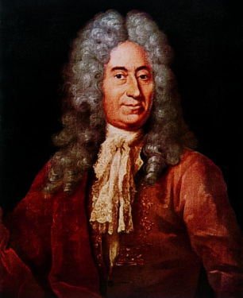
Rømer Revisited
A Modern Estimate of the Speed of Light from Observations of Jupiter’s Galilean Satellites
James Appleton
2016 January 23

Slide 2
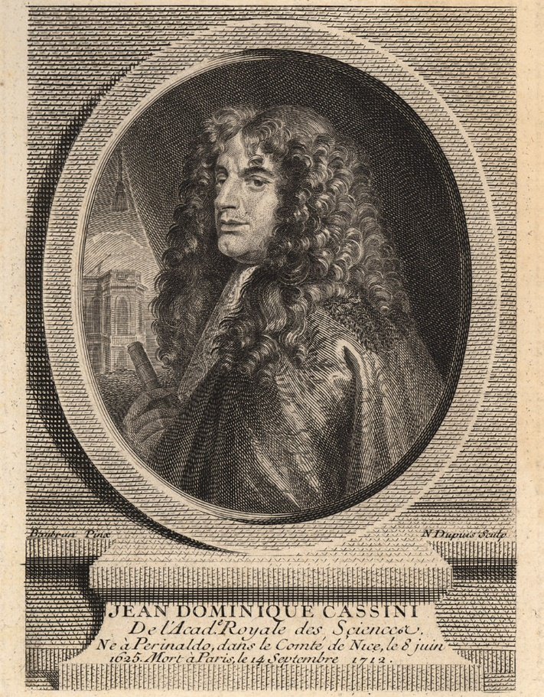
Ole Rømer
(1644-1710)
by Jacob Coning, circa 1700.
Giovanni Cassini
(1625-1712)

Slide 3
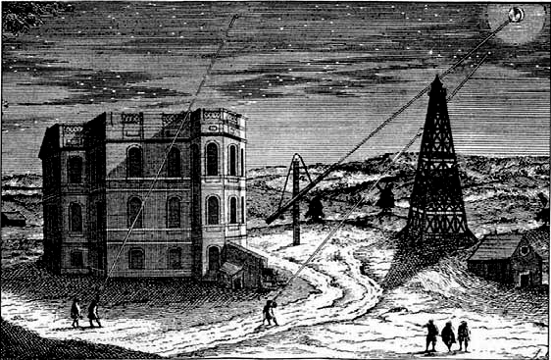
Observatoire de Paris, Early 18th C

Slide 4
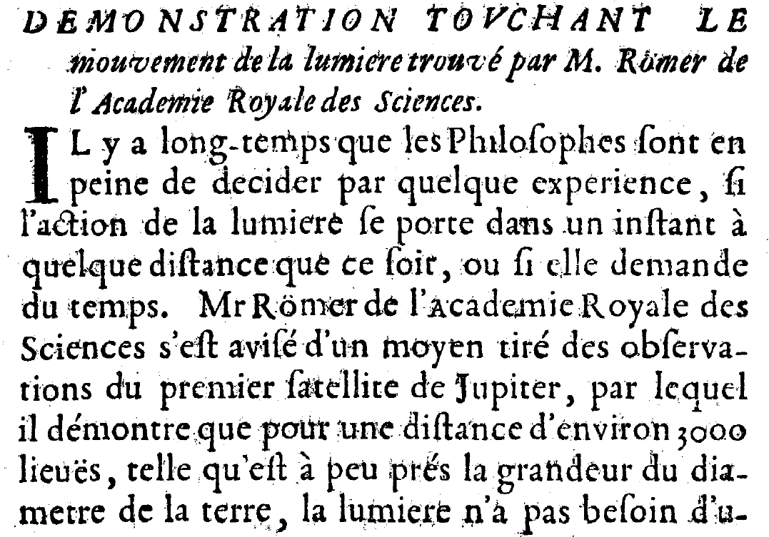
Journal des Sçavans, 1676

Slide 5
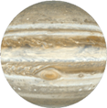

Orbital Configurations
NB: Diagram not to scale!
Conjunction
2
Opposition
1

Slide 6
Light Travel Times
NB: Diagram not to scale!
Speed of light, 299,792 km/s, equates to 8 min 19 sec per AU.
Difference in light travel time Jupiter → Earth between mean opposition (1) and mean conjunction (2) is: 16m 38s.
Conjunction
2
Mean conjunction:
51min 35sec
Opposition
1
Mean Opp: 34m 57s

Slide 7
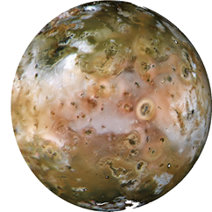
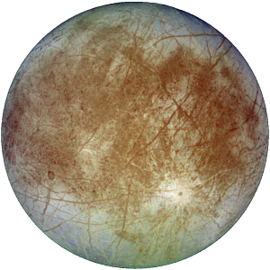
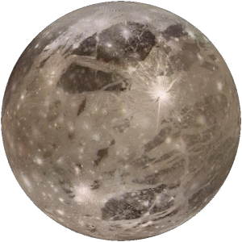
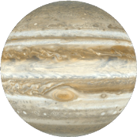
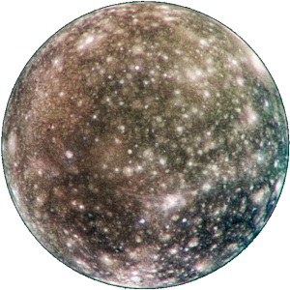
Jupiter & The Galilean Satellites
Io
Orbital radius 420,000 km
Orbital period: 1.8 days
NB: Diagram not to scale!
Europa
Orbital radius 670,000 km
Orbital period: 3.6 days
Ganymede
Orbital radius 1,070,000 km
Orbital period: 7.6 days
Callisto
Orbital radius 1,900,000 km
Orbital period: 16.7 days

Slide 8
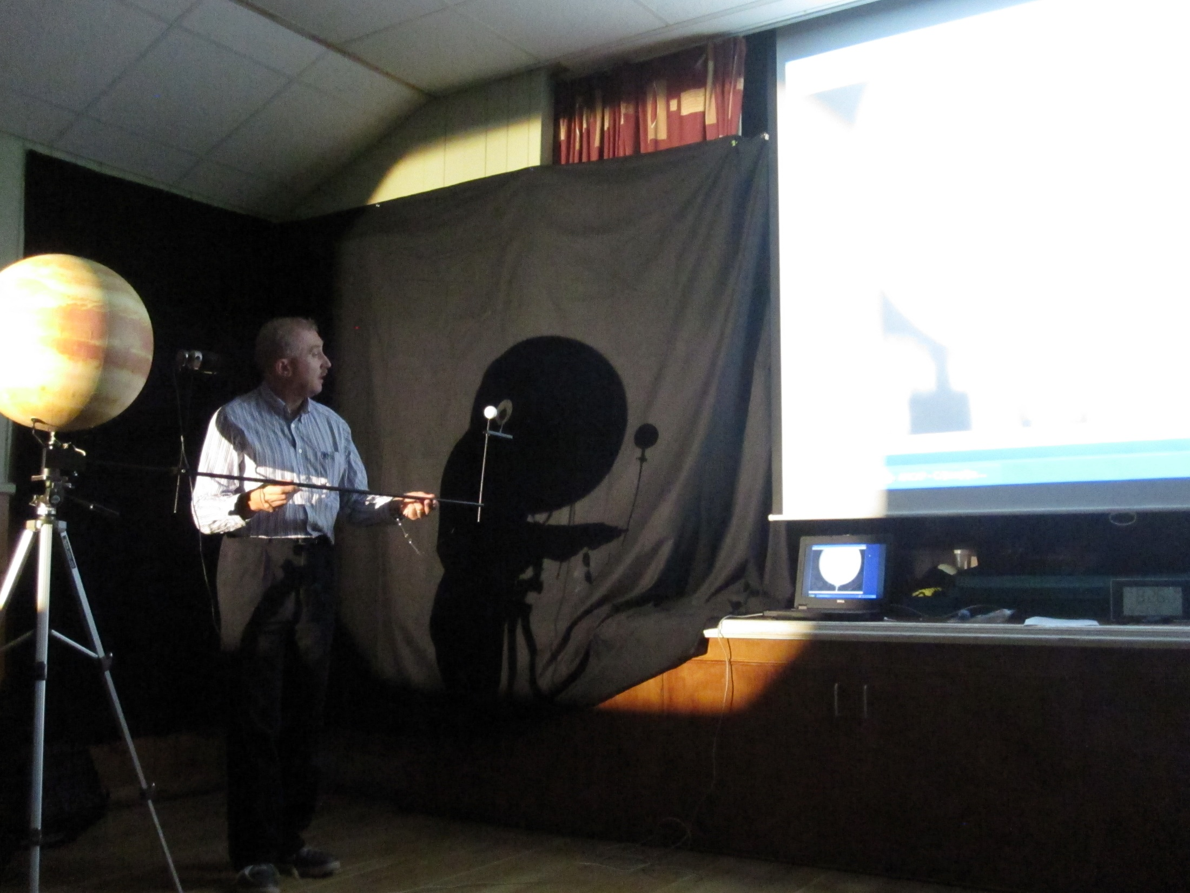
Scale Model (1:325,000,000)
“Jupiter”
Webcam
“Io”

Slide 9
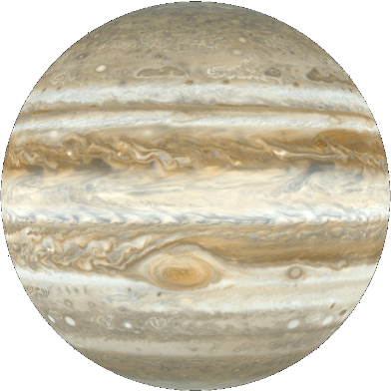


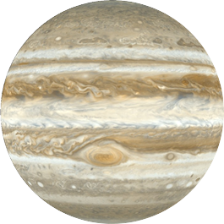
Phenomena of a Galilean
Transit
Galilean appears silhouetted against planet
Shadow Transit
Shadow of Galilean appears on planet
Occultation
Galilean disappears/reappears behind limb of planet
Eclipse
Galilean disappears into / reappears from shadow of planet

Slide 10
Effect of Axial Tilt of Jupiter
Normal to orbital plane
Axis
3.1°

Slide 11
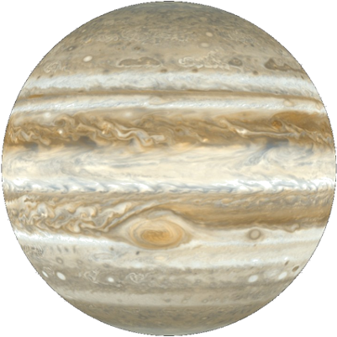

Sidereal and Synodic Periods
NB: Diagram not to scale!
3
2
1. Galilean in conjunction with Sun.
2. After a sidereal period, Galilean returns to same position relative to fixed stars.
3. After a synodic period, Galilean returns to same position relative to Sun.
1

Slide 12
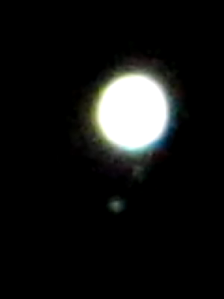
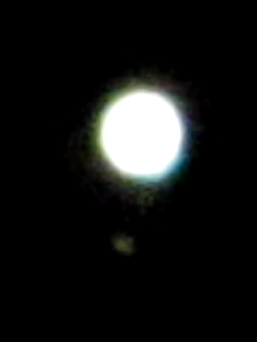
Io Disappearance Observation
Mike Whybray, 114mm Helios reflector, F/8, 9mm e/p, 100x mag. Eyepiece projection to compact digital camera.
Disappearance 20:32:44 UT on 2013 November 29
Io
Ganymede
Starts approx. two minutes before disappearance
Starts approx. 25 seconds before disappearance

Slide 13
Observations
Observational period 2012 January 14 – 2014 May 18
Observers
  OASI
  Hampshire Astronomical Group (HAG)
  Robin Scagell
Total 100 observations
  Two video
  98 eye and stopwatch
Of the 100 observations
  14 compromised by cloud or poor visibility
  86 retained for analysis
Distribution of Observations
 | D | R | Total
Io | 23 | 48 | 71
Europa |  | 12 | 12
Ganymede | 8 | 8 | 16
Callisto | 1 |  | 1
 |  |  | 100

Slide 14
“Rømer’s Method”
Key assumptions:
Eclipses are inherently periodic
Distance Jupiter – Earth is known
For a chosen Galilean, for a series of eclipses, either all disappearances or all reappearances, within a single apparition of Jupiter:
Observe and time an initial eclipse at O₁.
Corresponding time at Jupiter is O₁ – X.
Predicted time for subsequent eclipses at Jupiter is P = O₁ – X + nQ.
Time later eclipses and, for each, calculate the difference D_{i} = O_{i} – P_{i}.
Plot D_{i} vs Jupiter-Earth distance.
Slope of line is estimate of 1/c.
Invert and change units to estimate c in km/s.
Initial observed eclipse time
Unknown light time, Jupiter-Earth
Multiples of synodic period, Q, later
Evaluated using NASA JPL reference ephemeris DE-431

Slide 15
Results, Io

Slide 16
Results, Summary
Satellite | D / R | Observation Period | 1/c (min/AU) | c (km/sec)
Io | R | 2012 December 3 – 2013 May 6 2014 January 23 – May 18 | 8.06 6.53 | 309,000 382,000
Io | D | 2013 November 29 – December 29 | 4.45 | 560,000
Europa | R | 2013 January 9 – March 21 2014 March 15 – 22 | 27.8 22.6 | 90,000 110,000
Ganymede | R | 2012 November 3 – 2013 March 5 | 26.1 | 95,000
Ganymede | D | 2012 January 15 – February 19 2012 November 3 – 2013 March 12 | 26.8 11.7 | 95,000 213,000
Compound |  |  |  | 319,000

Slide 17
Synodic Periods
Galilean | Accepted Value | Empirical Estimate
Io | 1^{d} 18^{h} 28^{m} 35.97^{s} | +2.4^{s}
Europa | 3^{d} 13^{h} 17^{m} 53.85^{s} | +10.8^{s}
Ganymede | 7^{d} 3^{h} 59^{m} 36.31^{s} | +1^{m} 07.7^{s}
Historical footnote: in 1693, Cassini adopted the value 1^{d} 18^{h} 28^{m} 36^{s}

Slide 18
Further Investigations
The regularity of eclipses is a critical factor in Rømer’s method
In fact, eclipse times depart from regularity, due primarily to
  Jupiter’s orbital eccentricity
  Gravitational resonances and perturbations
  The inclination of the orbital planes of the Galileans to the orbital plane of Jupiter
Further investigation concentrated on understanding the effect of the above factors

Slide 19
Plot of ALPO Observations
Europa Emersion, 1991 March 22 – 2001 March 19
D (minutes) vs. distance (AU)

Slide 20
Variations in Eclipse Times
Max variation (±minutes) in eclipse times by factor
Galilean | Eccentricity of Jupiter’s Orbit | Gravitational Perturbation* | Orbital Inclination
Io | 40 | 3.8 | 2.1
Europa | 80 | 17 | 7.1
Ganymede | 160 | 11 | 29
Callisto | 373 | 62 | 71
* Estimated over the 601 year period 1600 – 2200.
c.f. 16m 38s, the difference in Jupiter → Earth light-travel time exploited by Rømer’s method.

Slide 21
Io
Europa
Callisto
Ganymede
Callisto

Slide 22
Critique of Rømer’s Method
Galilean | Applicability of Rømer’s Method
Io | √ | Can apply within one apparition of Jupiter. Eclipses relatively periodic within this timescale, so method will generally work.
Europa Ganymede Callisto | X | Eclipse times depart too much from strict periodicity for method to be used reliably.
Application of Rømer’s method beyond the above constraints necessitates additional correction factors.

Slide 23
Conclusions
The project was a great success!
Attracted 100 observations by two local astronomy societies
Adopted as NAW 2014 observing project
Theoretical analysis of the accuracy and applicability of “Rømer’s method”
The area has great potential depth for further work
An opportunity awaits…

